Slide 1
Module V
Internet Control Protocols – ICMP, ARP, RARP, BOOTP. Internet Multicasting – IGMP, Exterior Routing Protocols – BGP. IPv6 – Addressing – Issues, ICMPv6.

Slide 2
Internet Control Protocols
In addition to IP, which is used for data transfer, the Internet has several control protocols used in the network layer, including ICMP, ARP, RARP, BOOTP, and DHCP
ICMP - Internet Control Message Protocol:
  The operation of the Internet is monitored closely by the routers.
  When something unexpected occurs, the event is reported by the ICMP
  ICMP is also used to test the Internet.
  About a dozen types of ICMP messages are defined. The most important ones are listed in Fig.
  Each ICMP message type is encapsulated in an IP packet.

Slide 3
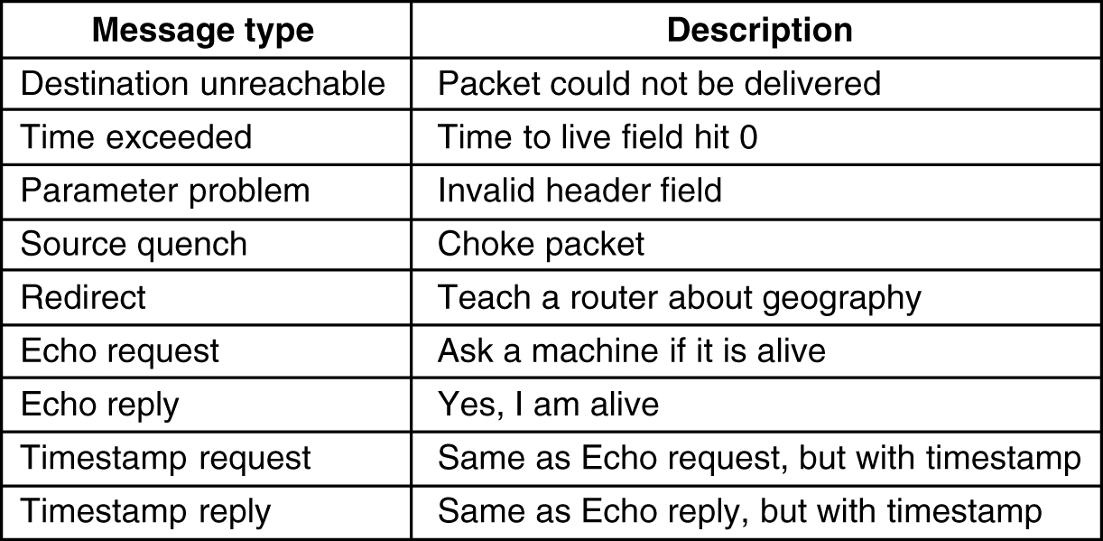
Internet Control Message Protocol
5-61
The principal ICMP message types.

Slide 4
Internet Control Protocols
DESTINATION UNREACHABLE message
  used when the subnet or a router cannot locate the destination or
  when a packet with the DF bit cannot be delivered because a ''small-packet'' network stands in the way
TIME EXCEEDED message
  sent when a packet is dropped because its counter has reached zero.
PARAMETER PROBLEM message
  indicates that an illegal value has been detected in a header field.
  This problem indicates a bug in the sending host's IP software or possibly in the software of a router transited.

Slide 5
Internet Control Protocols
SOURCE QUENCH message
  used to block hosts that were sending too many packets.
  When a host received this message, it was expected to slow down.
  It is rarely used any more because when congestion occurs, these packets tend to add more fuel to the fire.
  Congestion control in the Internet is now done largely in the transport layer
REDIRECT message
  used when a router notices that a packet seems to be routed wrong.
  It is used by the router to tell the sending host about the probable error.

Slide 6
Internet Control Protocols
ECHO and ECHO REPLY messages
  used to see if a given destination is reachable and alive.
  Upon receiving the ECHO message, the destination is expected to send an ECHO REPLY message back.
TIMESTAMP REQUEST and TIMESTAMP REPLY messages
  similar, except that the arrival time of the message and the departure time of the reply are recorded in the reply.
  This facility is used to measure network performance

Slide 7
Internet Control Protocols
ARP - The Address Resolution Protocol
  IP addresses cannot actually be used for sending packets
  because the data link layer hardware does not understand Internet addresses.
  most hosts at companies and universities are attached to a LAN by an interface board that only understands LAN addresses.
  For example, every Ethernet board comes equipped with a 48-bit Ethernet address.
  Manufacturers of Ethernet boards request a block of addresses from a central authority to ensure that no two boards have the same address
  The boards send and receive frames based on 48-bit Ethernet addresses.
  They know nothing at all about 32-bit IP addresses.

Slide 8
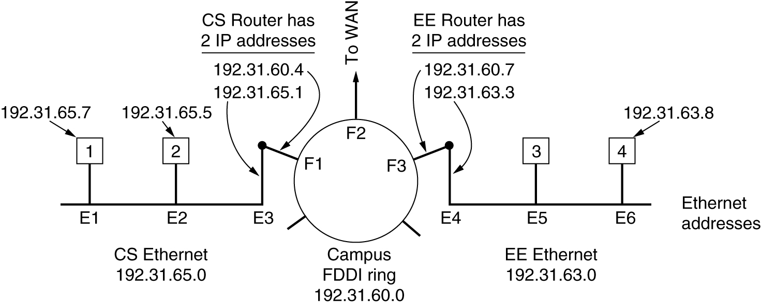
ARP - The Address Resolution Protocol
Three interconnected /24 networks: two Ethernets and an FDDI ring.

Slide 9
Internet Control Protocols
how a user on host 1 sends a packet to a user on host 2.
  Let us assume the sender knows the name of the intended receiver, possibly something like xyz@cs.uni.edu
  The first step is to find the IP address for host 2, known as cs.uni.edu.
  This lookup is performed by the Domain Name System (DNS) which returns the IP address for host 2 (192.31.65.5).
  upper layer software on host 1 now builds a packet with 192.31.65.5 in the Destination address field and gives it to the IP software to transmit.
  The IP software can look at the address and see that the destination is on its own network
  but it needs some way to find the destination's Ethernet address

Slide 10
Internet Control Protocols
One solution
  to have a configuration file somewhere in the system that maps IP addresses onto Ethernet addresses.
  While this solution is certainly possible, for organizations with thousands of machines, keeping all these files up to date is an error-prone, time-consuming job.
Better solution
  to output a broadcast packet onto the Ethernet asking: Who owns IP address 192.31.65.5?
  The broadcast will arrive at every machine on Ethernet 192.31.65.0, and each one will check its IP address.
  Host 2 alone will respond with its Ethernet address (E2).
  The protocol used for asking this question and getting the reply is called ARP (Address Resolution Protocol)
  Almost every machine on the Internet runs it.

Slide 11
Internet Control Protocols
RARP - Reverse Address Resolution Protocol
  Given an Ethernet address, what is the corresponding IP address?
  this problem occurs when a diskless workstation is booted.
  Such a machine will normally get the binary image of its OS from a remote file server.
  But how does it learn its IP address?
  RARP allows a newly-booted workstation to broadcast its Ethernet address and say: My 48-bit Ethernet address is 14.04.05.18.01.25.
  Does anyone out there know my IP address?
  The RARP server sees this request, looks up the Ethernet address in its configuration files, and sends back the corresponding IP address.

Slide 12
Internet Control Protocols
.
Disadvantage of RARP
  uses a destination address of all 1s (limited broadcasting) to reach the RARP server.
  Such broadcasts are not forwarded by routers
  So, a RARP server is needed on each network
  To overcome this problem, BOOTP was invented

Slide 13
Internet Control Protocols
BOOTP - bootstrap protocol
  BOOTP uses UDP messages, which are forwarded over routers.
  It also provides a diskless workstation with additional information, including
    IP address of the file server holding the memory image,
    IP address of the default router, and
    subnet mask to use.

Slide 14
Internet Control Protocols
Serious problem with BOOTP
  requires manual configuration of tables mapping IP address to Ethernet address.
  When a new host is added to a LAN, it cannot use BOOTP until an administrator has assigned it an IP address and entered its (Ethernet address, IP address) into the BOOTP configuration tables by hand.
  To eliminate this error-prone step, BOOTP was extended and given a new name: DHCP (Dynamic Host Configuration Protocol)

Slide 15
Internet Control Protocols
DHCP - Dynamic Host Configuration Protocol
  DHCP allows both manual IP address assignment and automatic assignment.
  In most systems, it has largely replaced RARP and BOOTP.
  Like RARP and BOOTP, DHCP is based on the idea of a special server that assigns IP addresses to hosts asking for one.
  This server need not be on the same LAN as the requesting host.
  Since the DHCP server may not be reachable by broadcasting, a DHCP relay agent is needed on each LAN

Slide 16
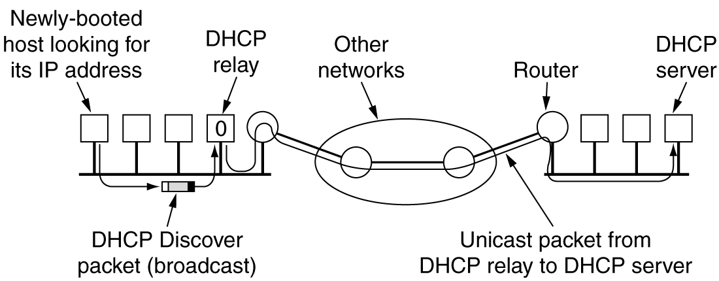
Dynamic Host Configuration Protocol
Operation of DHCP.

Slide 17
Internet Control Protocols
To find its IP address, a newly-booted machine broadcasts a DHCP DISCOVER packet.
The DHCP relay agent on its LAN captures all DHCP broadcasts.
When it finds a DHCP DISCOVER packet, it sends the packet as a unicast packet to the DHCP server, possibly on a distant network.
The only piece of information the relay agent needs is the IP address of the DHCP server.

Slide 18
Internet Control Protocols
Issue that arises with automatic assignment of IP addresses from a pool
  how long an IP address should be allocated.
  If a host leaves the network and does not return its IP address to the DHCP server, that address will be permanently lost.
  After a period of time, many addresses may be lost.
  To prevent that from happening, IP address assignment may be for a fixed period of time, a technique called leasing.
  Just before the lease expires, the host must ask the DHCP for a renewal.
  If it fails to make a request or the request is denied, the host may no longer use the IP address it was given earlier.

Slide 19
Internet Multicasting
Ability to send to a large number of receivers simultaneously
Eg:
  updating replicated, distributed databases
  transmitting stock quotes to multiple brokers and
  handling digital conference telephone calls
IP supports multicasting using class D addresses
Each class D address identifies a group of hosts
28 bits are available for identifying groups, so over 250 million groups can exist at the same time.
When a process sends a packet to a class D address, a best-efforts attempt is made to deliver it to all the members of the group addressed, but no guarantees are given
some members may not get the packet

Slide 20
Internet Multicasting
Two kinds of group addresses are supported:
  permanent addresses and
  temporary addresses .
permanent group is always there and does not have to be set up.
Each permanent group has a permanent group address
Some examples of permanent group addresses are:
  224.0.0.1 All systems on a LAN
  224.0.0.2 All routers on a LAN
  224.0.0.5 All OSPF routers on a LAN
  224.0.0.6 All designated OSPF routers on a LAN

Slide 21
Internet Multicasting
Temporary groups must be created before they can be used.
A process can ask its host to join a specific group.
It can also ask its host to leave the group.
When the last process on a host leaves a group, that group is no longer present on the host.
Each host keeps track of which groups its processes currently belong to.
Multicasting is implemented by special multicast routers
About once a minute, each multicast router sends a hardware (i.e., data link layer) multicast to the hosts on its LAN (address 224.0.0.1) asking them to report back on the groups their processes currently belong to.
Each host sends back responses for all the class D addresses it is interested in.

Slide 22
Internet Multicasting
These query and response packets use a protocol called IGMP (Internet Group Management Protocol),
  which is vaguely analogous to ICMP.
It has only two kinds of packets:
  query and response
    each with a simple, fixed format containing some control information in the first word of the payload field and a class D address in the second word.
Multicast routing is done using spanning trees.
  spanning tree of a connected, undirected graph, G is a tree that includes all of the vertices and some of the edges of G such that it becomes a tree, i.e, it contains no more cycles.

Slide 23
Internet Multicasting
Each multicast router exchanges information with its neighbors, using a modified distance vector protocol
in order for each one to construct a spanning tree per group covering all group members.
Various optimizations are used to prune the tree to eliminate routers and networks not interested in particular groups.
The protocol makes heavy use of tunneling to avoid bothering nodes not in a spanning tree.

Slide 24
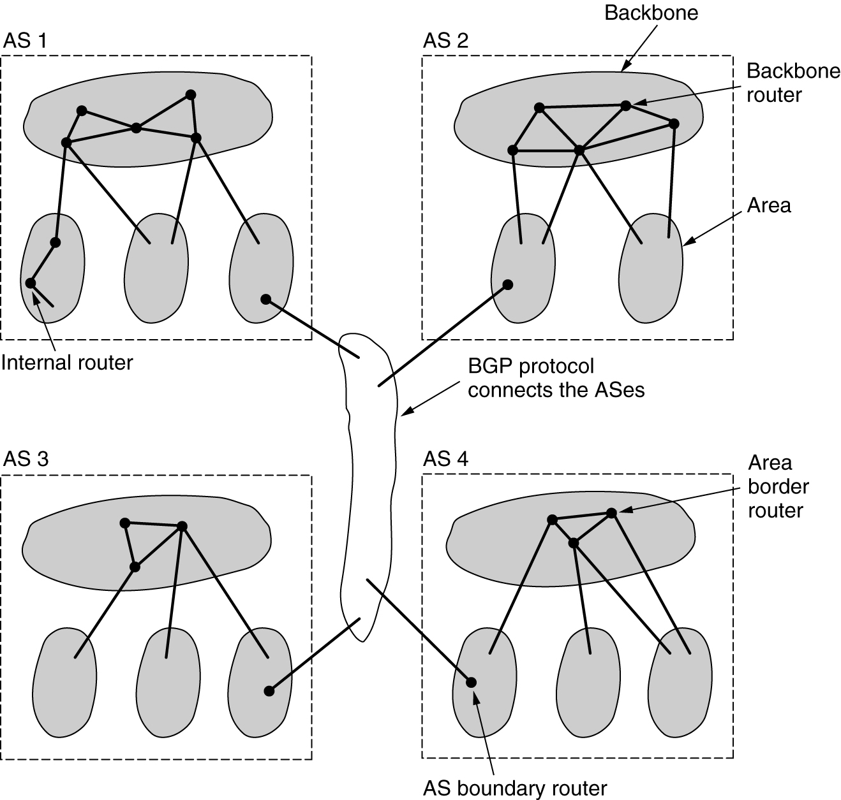
Exterior Gateway Routing Protocol - BGP

Slide 25
Exterior Gateway Routing Protocol - BGP
For routing between ASes, BGP (Border Gateway Protocol) is used
Exterior gateway protocol routers have to worry about politics
For example, a corporate AS might want the ability to send packets to any Internet site and receive packets from any Internet site.
However, it might be unwilling to carry transit packets originating in a foreign AS and ending in a different foreign AS, even if its own AS was on the shortest path between the two foreign ASes (''That's their problem, not ours'').
Telephone companies, for example, might be happy to act as a carrier for their customers, but not for others.

Slide 26
Exterior Gateway Routing Protocol - BGP
Exterior gateway protocols in general, and BGP in particular, have been designed to allow many kinds of routing policies to be enforced in the interAS traffic
Typical policies involve political, security, or economic considerations.
A few examples of routing constraints are
    No transit traffic through certain ASes
    Traffic starting or ending at IBM should not transit Microsoft
    Never put Iraq on a route starting at the Pentagon
From the point of view of a BGP router, the world consists of ASes and the lines connecting them

Slide 27
Exterior Gateway Routing Protocol - BGP
Given BGP's special interest in transit traffic, networks are grouped into one of 3 categories.
Category 1: stub networks
  which have only one connection to the BGP graph.
  cannot be used for transit traffic because there is no one on the other side.
Category 2: multiconnected networks
  could be used for transit traffic, except that they refuse.
Category 3: transit networks
  such as backbones, which are willing to handle third-party packets
  possibly with some restrictions, and usually for pay

Slide 28
Exterior Gateway Routing Protocol - BGP
Pairs of BGP routers communicate with each other by establishing TCP connections.
Operating this way provides reliable communication and hides all the details of the network being passed through.
BGP is fundamentally a distance vector protocol
Instead of maintaining just the cost to each destination, each BGP router keeps track of the path used.
Similarly, instead of periodically giving each neighbor its estimated cost to each possible destination, each BGP router tells its neighbors the exact path it is using
Eg is illustrated in the next slide figure

Slide 29
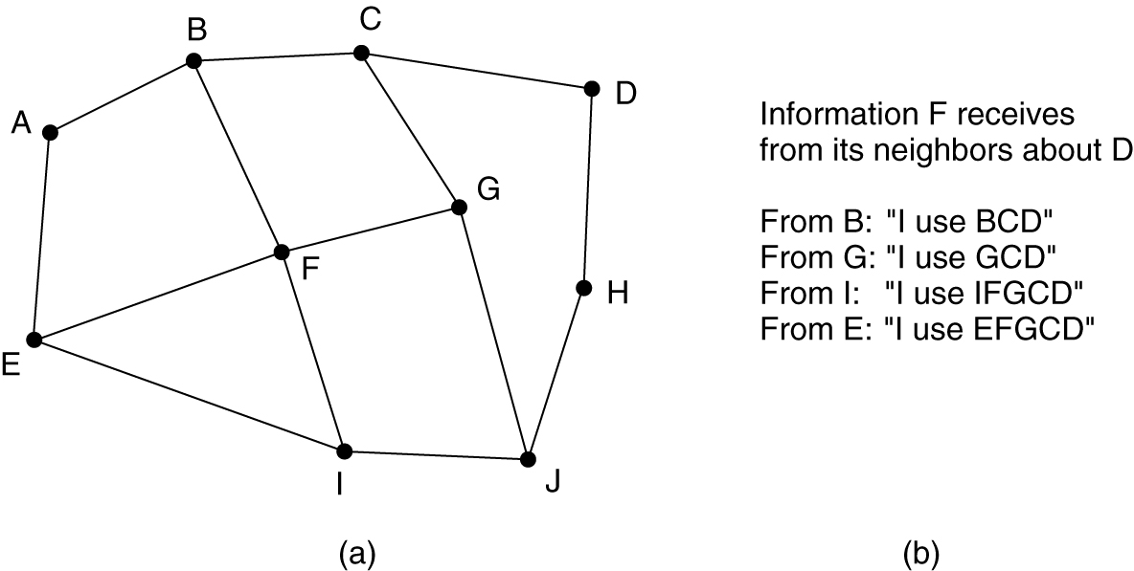
BGP – The Exterior Gateway Routing Protocol
(a) A set of BGP routers. (b) Information sent to F.

Slide 30
Exterior Gateway Routing Protocol - BGP
consider F's routing table.
Suppose that it uses the path FGCD to get to D.
When the neighbors give it routing information, they provide their complete paths
After all the paths come in from the neighbors, F examines them to see which is the best.
It quickly discards the paths from I and E, since these paths pass through F itself.
The choice is then between using B and G.
Every BGP router contains a module that examines routes to a given destination and scores them, returning a number for the ''distance'' to that destination for each route.

Slide 31
Exterior Gateway Routing Protocol - BGP
Any route violating a policy constraint automatically gets a score of infinity.
The router then adopts the route with the shortest distance.
The scoring function is not part of the BGP protocol and can be any function the system managers want.
BGP easily solves the count-to-infinity problem
For example, suppose G crashes or the line FG goes down.
F then receives routes from its three remaining neighbors. These routes are BCD, IFGCD, and EFGCD.
It can immediately see that the two latter routes are pointless, since they pass through F itself, so it chooses FBCD as its new route.

Slide 32
IPv6
Major goals were:
    1. Support billions of hosts, even with inefficient address space allocation.
    2. Reduce the size of the routing tables.
    3. Simplify the protocol, to allow routers to process packets faster.
    4. Provide better security (authentication and privacy) than current IP.
    5. Pay more attention to type of service, particularly for real- time data.
    6. Aid multicasting by allowing scopes to be specified.
    7. Make it possible for a host to roam without changing its address.
    8. Allow the protocol to evolve in the future.
    9. Permit the old and new protocols to coexist for years.

Slide 33
IPv6
  IPv6 represents a big advance is in security.
    Authentication and privacy are key features of new IP.
    These were later added to IPv4
  more attention has been paid to quality of service
    with the growth of multimedia on the Internet, the sense of urgency is greater
Main IPv6 Header is shown in the next slide
  Version field is always 6 for IPv6 (4 for IPv4 )
    During the transition period from IPv4, router will be able to examine this field to tell what kind of packet they have

Slide 34
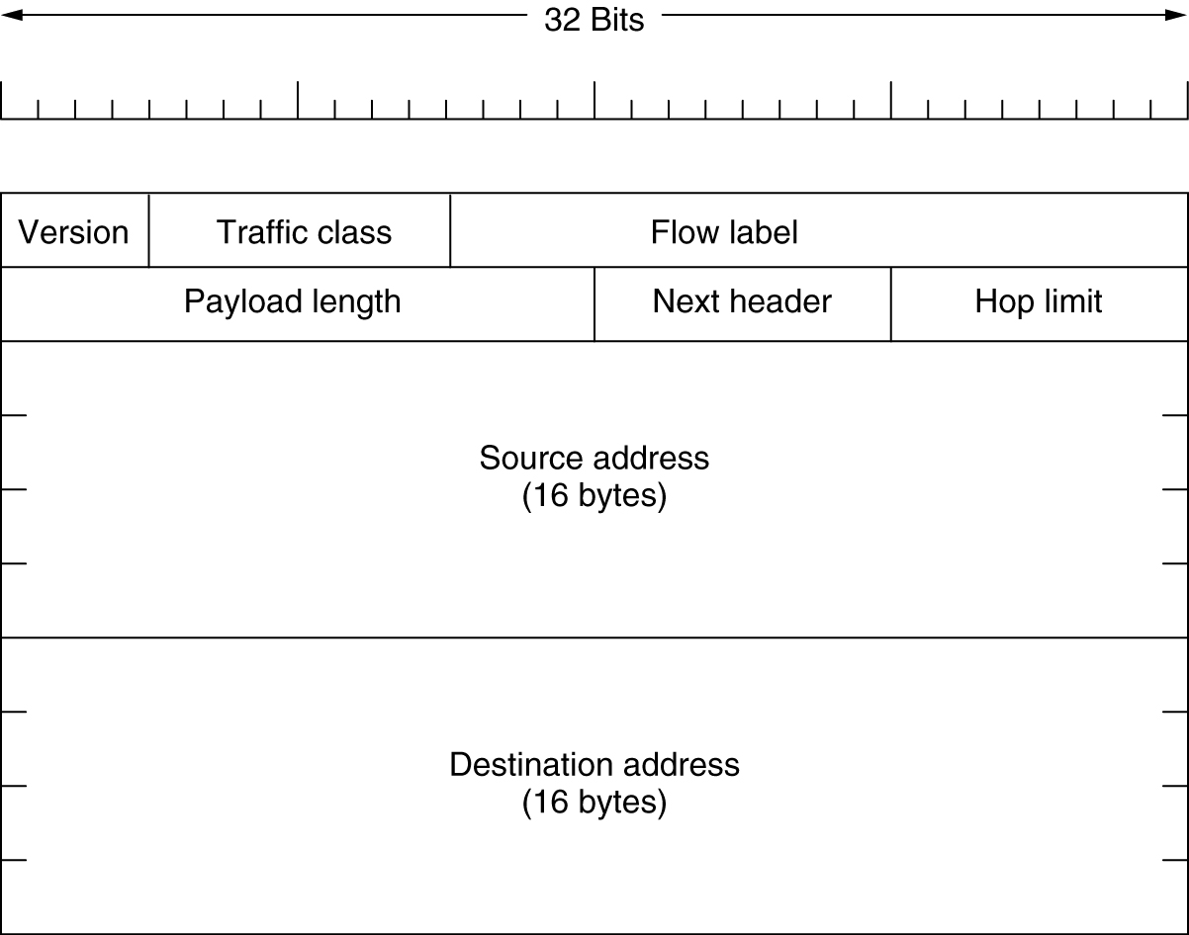
The Main IPv6 Header
The IPv6 fixed header (required).

Slide 35
IPv6
Traffic class field
  used to distinguish between packets with different real-time delivery requirements.
  A field designed for this purpose has been in IP since the beginning, but it has been only periodically implemented by routers.
  Experiments are now underway to determine how best it can be used for multimedia delivery
Flow label field
  also still experimental
  but will be used to allow a source and destination to set up a pseudo-connection with particular properties and requirements.

Slide 36
IPv6
Payload length field
  tells how many bytes follow the 40-byte main header
  The name was changed from the IPv4 Total length field because the meaning was changed slightly:
    the 40 header bytes are no longer counted as part of the length

Slide 37
IPv6
Next header field
  there can be additional (optional) extension headers.
  This field tells which of the (currently) six extension headers follow this one.
  If this header is the last IP header, the Next header field tells which transport protocol handler (e.g., TCP, UDP) to pass the packet to.
Hop limit field
  used to keep packets from living forever.
  same as the Time to live field in IPv4, namely, a field that is decremented on each hop.
  In theory, in IPv4 it was a time in seconds, but no router used it that way
  so the name was changed to reflect the way it is actually used

Slide 38
IPv6
Source address and Destination address fields
  16-byte addresses
  They are written as eight groups of four hexadecimal digits with colons between the groups
  8000:0000:0000:0000:0123:4567:89AB:CDEF

Slide 39
IPv6
  Since many addresses will have many zeros inside them, three optimizations have been authorized.
    leading zeros within a group can be omitted, so 0123 can be written as 123.
    one or more groups of zero bits can be replaced by a pair of colons
    The above address now becomes
    8000::123:4567:89AB:CDEF

Slide 40
IPv6
Compare the IPv4 header with the IPv6 header
  IHL field is gone because the IPv6 header has a fixed length.
  Protocol field was taken out because the Next header field tells what follows the last IP header (e.g., a UDP or TCP segment).
  All the fields relating to fragmentation were removed because IPv6 takes a different approach to fragmentation
    hosts are expected to dynamically determine the datagram size to use.
    router that is unable to forward it sends back an error message
    This message tells the host to break up all future packets to that destination
  Checksum field is gone because calculating it greatly reduces performance (data link layer and transport layers normally have their own checksums)

